Slide 1
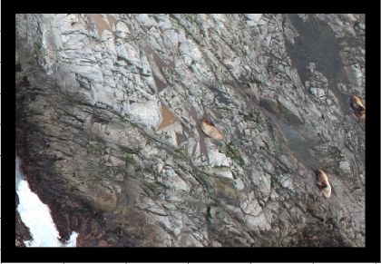

first training pair
patch
target
second training pair

